Slide 1
BRITISH AIRWAYS TASK 2
PREDICTION OF CUSTOMER BOOKING
SAREENA BILAL
sb743915@gmail.com

Slide 2
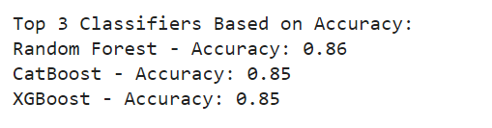
3 BEST-PERFORMING MODELS BASED ON ACCURACY

Slide 3
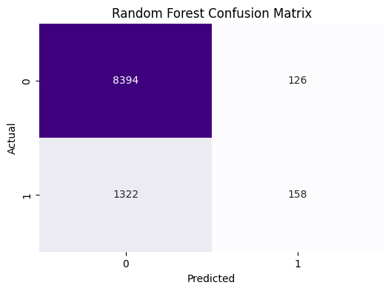
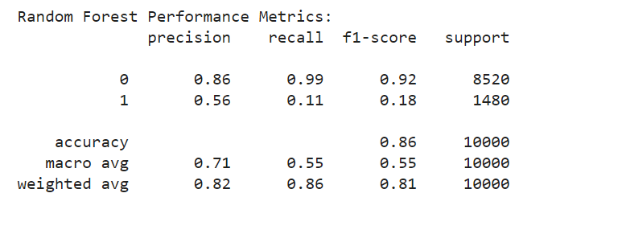
RANDOM FOREST

Slide 4
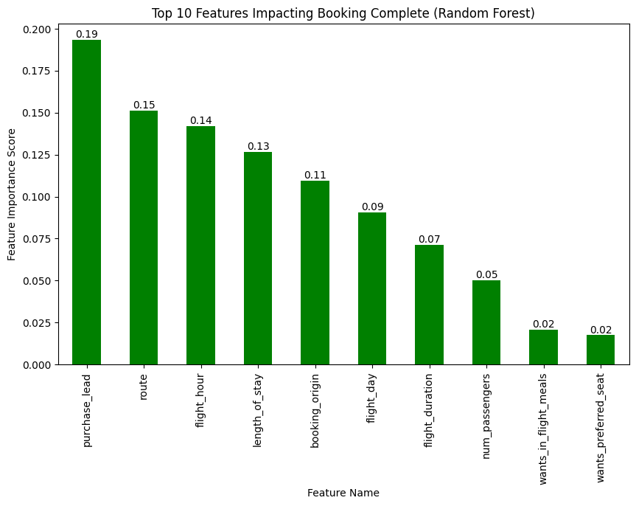
RANDOM FOREST RESULT

Slide 5
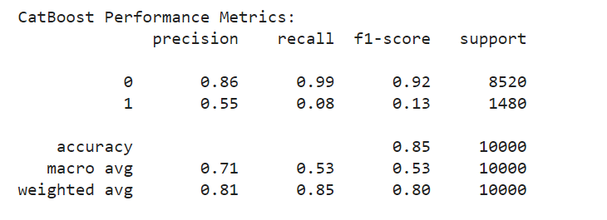
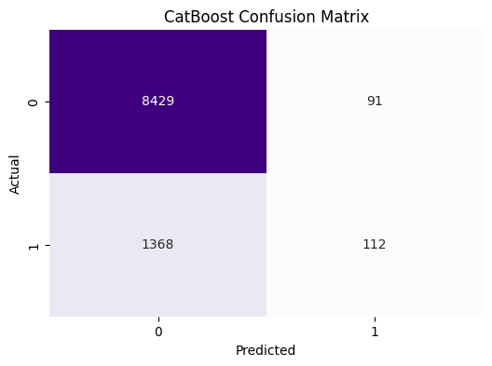
CAT BOOST

Slide 6
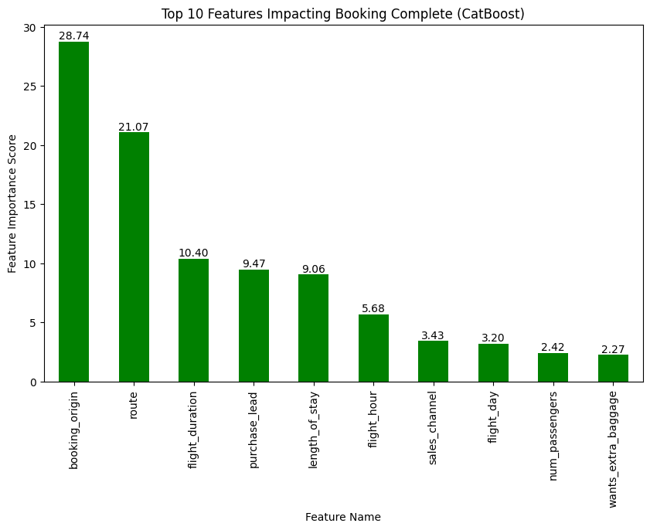
CAT BOOST RESULT

Slide 7
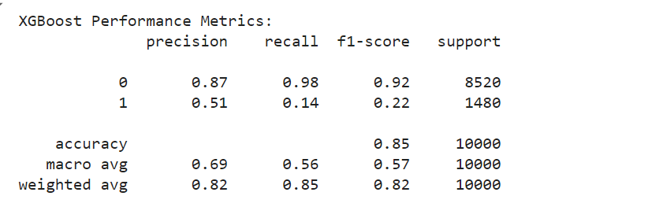

XGBOOST

Slide 8
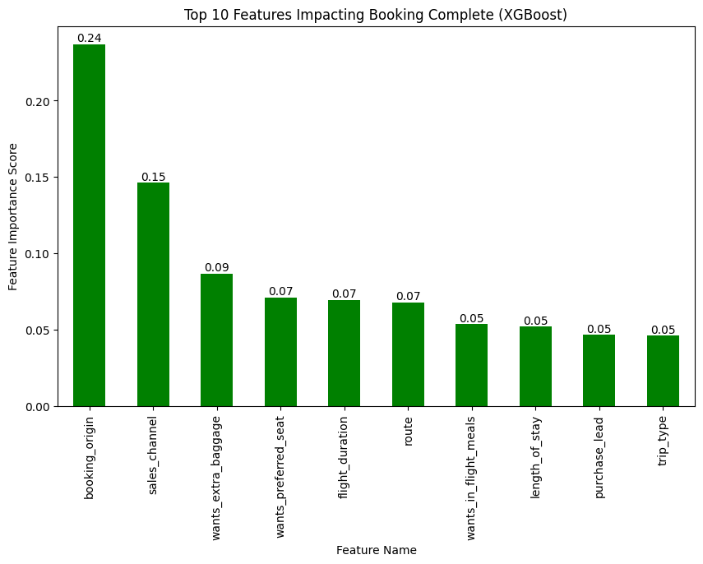
XGBOOST RESULT

